Slide 1
Cell Transport Mechanisms
Biology

Slide 2
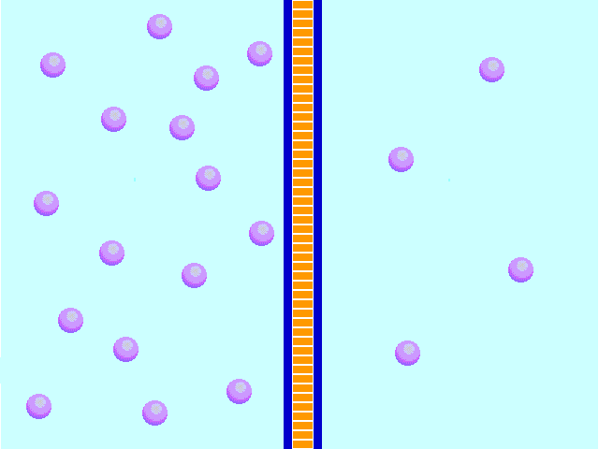
Diffusion
Molecules move from areas of greater concentration to areas of lesser concentration
Facilitated diffusion uses special proteins that target specific molecules
http://www.nsf.gov/news/mmg/mmg_disp.cfm?med_id=57229&from=mn
http://www.d.umn.edu/~sdowning/Membranes/diffusionanimation.html

Slide 3
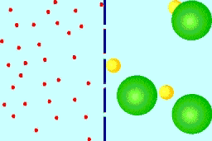
Osmosis
A special type of diffusion in which water molecules move across a semi-permeable membrane
Water can move through the membrane – but other molecules can’t

Slide 4
Active Transport Pumps
Proteins that use energy to move specific ions or molecules into the cell
The energy comes from chemical reactions that previously took place in the cell – this energy is harnessed as ATP
http://www.brookscole.com/chemistry_d/templates/student_resources/shared_resources/animations/ion_pump/ionpump.html

Slide 5
Endo- and Exocytosis
Endocytosis is a process by which large or charged particles enter the cell by forming vesicle packages that “pinch” from the cell membrane
Exocytosis is the reverse of endocytosis – vesicles with large or charged particles combine with the cell membrane and “spit out” their contents
“Endocytosis and Exocytosis.swf”

